Slide 1
Data Management
Business Information Systems – 420-E01
Reference: Chapter 4 Rainer, Introduction to Information Systems, 2nd Can. Ed.
Notes:
Pfeiffer book, Chapter 3-5

Slide 2
How Much Data Does a Company Collect?
Think of the process of buying a book online at Amazon.com.
What information does Amazon collect from you?
How many transactions does Amazon do in one day?
On Cyber Monday, Amazon did 3 million transactions per second!!
That’s a lot of data…

Slide 3
Examples
Walmart processes more than 1 million customer transactions every hour.
Walmart’s data warehouses are estimated to contain 2.5 petabytes of data!
Facebook contains more than 40 billion photographs.
Hundreds of terabytes of data

Slide 4
Big Data
The superabundance of data available today.
“Big Data” allows us to:
Spot trends more rapidly and accurately
Prevent disease
Track crime
“Big Data”creates problems:
More data than space to store the data
Quantity growing faster than networks can handle
Hard to protect data security and personal privacy

Slide 5
Opening Case
China Foods Adopts Database Management System
COFCO Group is one of China’s largest enterprises, with over 100,000 employees, and it specializes in importing and exporting food products. One of its subsidiaries, China Foods Limited, is the market leader in the food industry, selling wines, oils, confectionery, and other food products.

Slide 6
Opening Case
The Business Problem
China Foods Limited grew rapidly through a number of mergers and acquisitions. This created a number of problems, especially with regards to integrating the information systems of the newly acquired subsidiaries. Data errors, duplication, and data inconsistencies across subsidiaries became everyday problems.

Slide 7
Opening Case
The case of China Foods represents the very real problems that almost every business faces as it grows, regarding one of its most valuable resources: data.
Data problems become even more pronounced when we consider the incredibly rapid increase in the amount of data that organizations store. The opportunity for errors in the data is increasing exponentially as businesses expand.
Increasingly, more and more businesses, like COFCO, are investing in database technology to manage their valuable data so that they can better support their business processes and ultimately improve profitability.

Slide 8
Data Quality
Information technologies and systems support organizations in managing their data.
Organizing, storing, accessing, analyzing, interpreting the data
Data needs to be high quality
Accurate, complete, timely, consistent, accessible, relevant, concise
It’s difficult to have high quality data
Processed in several stages, and often in several places

Slide 9
Difficulties in Managing Data
Amount of data increases exponentially
Large firms have to manage terabytes of data
Data are scattered and collected by many individuals using various methods and devices
Different servers, different applications, different languages
Data come from many sources
Data security, quality, and integrity are critical

Slide 10

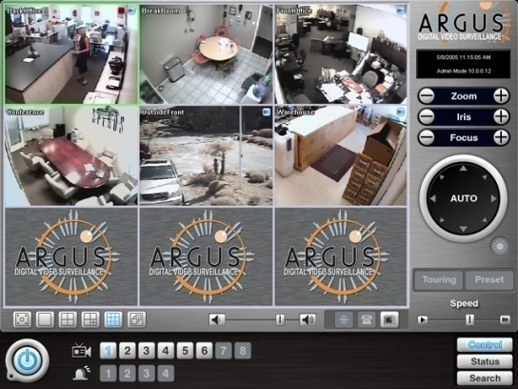




Data Source Examples
RFID tags
Credit card swipes
Digital video surveillance
E-mails
Radiology scans
Blogs

Slide 11
Difficulties in Managing Data
Data degrades over time.
Customers move to new addresses or change their names
Companies go out of business or are bought
New products are developed
Employees are hired or fired

Slide 12
Difficulties in Managing Data
Data rot – problems with the media on which data is stored.
Temperature, humidity, light exposure cause physical problems
Technologies change – can be hard to find machines needed to access old data
Data errors
Data gets out of date, inaccurate, technically corrupt

Slide 13
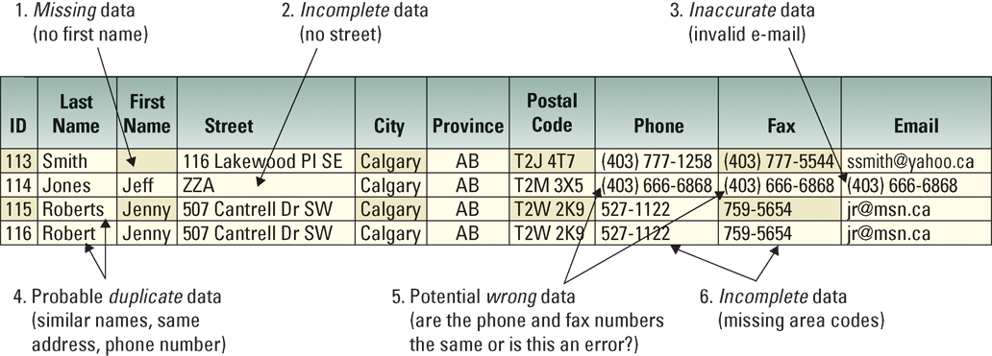
An Example of Low Quality Data
Notes:
Walk-through each of the six issues and have your students extrapolate a potential business problem that might be associated with each issue. The example does not state what type of database or spreadsheet this information is contained (sales, marketing, customer service, billing, etc), so allow your students use their imagination when they are extrapolating the potential business problems
Issue 1: Without a first name it would be impossible to correlate this customer with customers in other databases (Sales, Marketing, Billing, Customer Service) to gain a compete customer view (CRM)
Issue 2: Without a complete street address there is no possible way to communicate with this customer via mail or deliveries. An order might be sitting in a warehouse waiting for the complete address before shipping. The company has spent time and money processing an order that might never be completed
Issue 3: If this is the same customer, the company will waste money sending out two sets of promotions and advertisements to the same customers. It might also send two identical orders and have to incur the expense of one order being returned
Issue 4: This is a good example of where cleaning data is difficult because this may or may not be an error. There are many times when a phone and a fax have the same number. Since the phone number is also in the e-mail address field, chances are that the number is inaccurate
Issue 5: The business would have no way of communicating with this customer via e-mail
Issue 6: The company could determine the area code based on the customer’s address. This takes time, which costs the company money. This is a good reason to ensure that information is entered correctly the first time. All incorrect information needs to be fixed, which costs time and money

Slide 14
Case Study – Mediatech Data Errors
It’s About Business 4.1 – Rainer. P 113
How important are accurate data for on-line businesses?
Is technology sufficient to guarantee that data errors will not occur? If not, then what other factors should a business need to consider?
Provide examples of cost savings that can be achieved by reducing data errors.
Notes:
How important are accurate data for on-line businesses?
Data accuracy is critical since inaccurate data and/or poor data integrity result in lost sales opportunities and the consequent revenues. Data errors can also degrade system performance and be very expensive to correct if detected.
2. Is technology sufficient to guarantee that data errors will not occur? If not, then what other factors should a business need to consider?
Technology of itself will not guarantee the prevention of errors. Beginning with appropriate data management policies, a business needs to ensure that data is effectively checked, cleansed and securely stored. Processing must also be audited to ensure the integrity and accuracy of information.
3. Provide examples of cost savings that can be achieved by reducing data errors.
Mediatech estimated that reconciling the data in one customer file would save the company more than $250,000 annually.
The company also estimated that overall cost savings through the elimination of data errors could approach $3 million per year.

Slide 15
What to do About Data Problems?
Because of these problems, data are difficult to manage.
As a result, organizations use databases and data warehouses to manage their data more efficiently and effectively, in a process called the data life cycle.

Slide 16
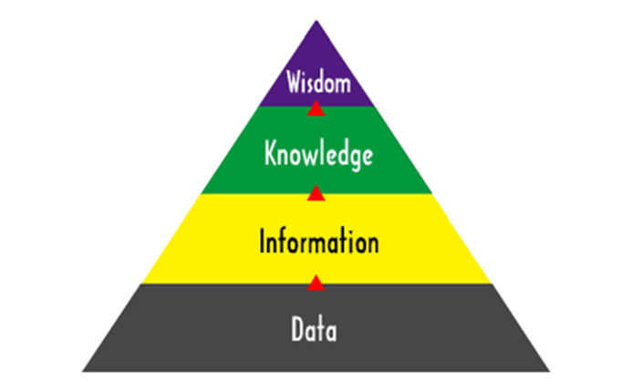
Data Life Cycle
Businesses run on data that have been processed into information and knowledge.
Managers then apply this knowledge to business problems and opportunities.
Businesses transform data into knowledge and solutions in several ways.
The general process is illustrated here and is referred to as the data life cycle.

Slide 17
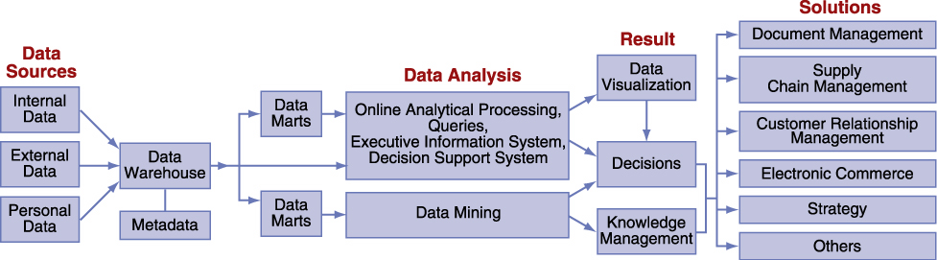
Data Processing
The processing of data into information and then knowledge.

Slide 18
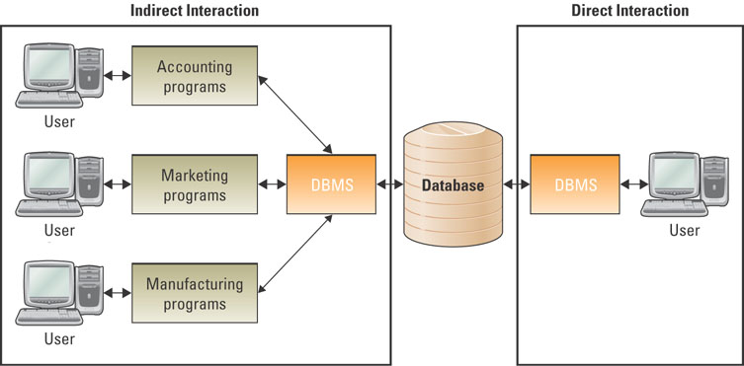
The Database Approach
A database management system (DBMS) is a set of programs that provide users with tools to add, delete, access, and analyze data stored in one location.
DBMS interfaces with the database, and provides all users with integrated access to the data.

Slide 19
The Database Approach
There are a number of different database architectures, but the relational database model is the most popular and most easy to use.
Other database models are also available such as the hierarchical, network, and object-oriented models.

Slide 20
Popular DBMS Products
DB2 from IBM
Access from Microsoft
SQL Server from Microsoft
Oracle from Oracle Corporation
MySQL – open-source

Slide 21
College Database Example

Slide 22
DBMS Benefits
In general, database management systems try to minimize the following problems:
Data redundancy
The same data are stored in many places
Data isolation
Applications cannot access data associated with other applications
Data inconsistency
Various copies of the data do not agree

Slide 23
DBMS Issues
In addition, database systems maximize the following issues:
Data security
Databases have extremely high security measures in place to deter mistakes and attacks
Data integrity
Data meet certain constraints, such as no alphabetic characters in a social insurance number field
Data independence
Applications and data are independent of one another (that is, applications and data are not linked to each other, meaning that applications can be designed to access the same data).

Slide 24
RDBMS
Relational Database Management Systems (RDMBS)
The Relational Database Model
Query Languages
Data Dictionary
Normalization

Slide 25
The Relational Database Model
The relational database model is based on the concept of two-dimensional tables.
A relational database generally is not one big table that contains all of the records and attributes.
Too much data redundancy.
Instead, a relational database is usually designed with a number of related tables.
Each of these tables contains entities (as records listed in rows) and attributes (as fields listed in columns).

Slide 26
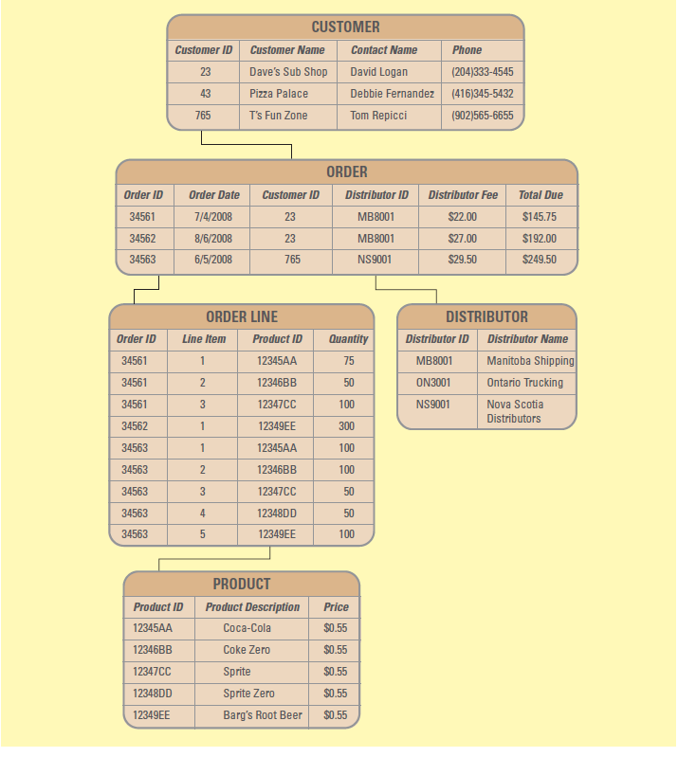
Relational Database Example
The Customer table is linked to the Order table by means of the Customer ID field.
Customer ID is the Foreign Key in the Order table.
The value 23 is a unique identifier for Dave’s Sub Shop and links the order to the customer.
Customer ID is a Primary Key in the Customer table. The value 23 is a unique identifier for Dave’s Sub Shop.
Notes:
Explain to your students that the logic that correlates the tables is implemented through the primary and foreign keys.
For example Manitoba Shipping in the DISTRIBUTOR table has a primary key called Distributor ID – MB8001.
Notice that in the Order Table, Manitoba Shipping(Distributor ID MB8001) is responsible for delivering orders 34561 and 345652.
Therefore, Distributor ID in the ORDER table creates a logical relationship (who shipped what order) between ORDER and DISTRIBUTOR.

Slide 27
RDBMS Query Languages
Requesting information from a database is the most commonly performed operation.
Structured query language (SQL) is the most popular query language used to request information.
SQL allows people to perform complicated searches by using relatively simple statements or key words.

Slide 28
RDBMS Data Dictionary
When a relational model is created, the data dictionary defines the format necessary to enter the data into the database.
The data dictionary provides information on each attribute, such as its name, whether it is a key or part of a key, the type of data expected (alphanumeric, numeric, dates, and so on), and valid values.

Slide 29
RDBMS Normalization
Normalization is a method for analyzing and reducing a relational database to its most streamlined form for:
Minimum redundancy
Maximum data integrity
Best processing performance
Normalized data is when attributes in the table depend only on the primary key.

Slide 30
Relational Database Advantages
Database advantages from a business perspective include:
Increased flexibility.
Increased scalability and performance.
Reduced redundancy.
Increased integrity (quality).
Increased security.
Notes:
All of the above are discussed in the following slides:
A good way to explain databases is to compare them to spreadsheets
What are the limitations when using a spreadsheet?
Limited number of rows and columns (Excel - 65,536 rows by 256 columns) Once you use more than 65,536 rows you have outgrown your spreadsheet
Only one user can access the spreadsheet
Users can view all information in the spreadsheet
Users can change all information in the spreadsheet
All of the disadvantages associated with a spreadsheet are fixed when using a database
These advantages are discussed in detail over the next several slides

Slide 31
Advantage 1: Increased Flexibility
A well-designed database should:
Handle changes quickly and easily
Provide users with different views
Have only one physical view
Physical view – deals with the physical storage of information on a storage device
Have multiple logical views
Logical view – focuses on how users logically access information
Notes:
The separation between logical and physical views is what allows each user to access database information differently
What would happen if a new database called “Real Data” hit the market and allowed only one logical view?
The “Real Data” database simply would never sell. With only one logical view every person in an entire organization would have the same view. Different needs in different functional units would never be accommodated.
Define two database views for your school’s student database (one for students, and one for instructors)
What does the student view display when a student accesses the school’s student database?
Courses enrolled
Grades
Tuition
Credits for graduation
What does the instructor view display when an instructor accesses the school’s student database?
Courses teaching
Students in each course
Payment information
Vacation time

Slide 32
Advantage 2: Increased Scalability & Performance
A database must increase or decrease in size to meet increased demand, while maintaining acceptable performance levels.
Scalability – refers to how well a system can adapt its capacity to changing demands.
Performance – measures how quickly a system performs a certain process or transaction.
Notes:
What happens to a business if it suddenly experienced a 60 percent growth in sales and its IT systems fail with all of the increased activity?
Remind your students that a big part of developing successful IT systems is being able to anticipate future growth
CLASSROOM EXERCISE
Building an Relational Database Diagram
Break your students into groups and ask them to create a database diagram similar to the one in Figure 7.5 for a company or product of their choice. If the students are uncomfortable with databases, you should recommend that they stick to a company similar to the TCCBCE, perhaps a snack food producer, mountain bike equipment producer, or even a footwear producer. If your students are more comfortable with databases, ask them to choose a company that would challenge them, such as a fast food restaurant, online book seller, or even a university’s course registration system.
The important part of this exercise is for your students to begin to understand how the tables in a database relate. Be sure their diagrams include primary keys and foreign keys. Have your students present their diagrams to the class and ask the students to find any potential errors with the diagrams.

Slide 33
Advantage 3: Reduced Data Redundancy
Databases reduce Data Redundancy – the duplication of information or storing the same information in multiple places
Problems include:
Inconsistency of data describing the same thing.
Waste of space, waste of time to enter and update.
Difficulty securing data in many places.
Notes:
One of the primary goals of a database is to eliminate information redundancy by recording each piece of information in only one place
This is a good time to tie the discussion back to the material in the previous chapter, low quality information
Recall what happens when a single customer is stored twice with different phone numbers, addresses, or order information in a single database

Slide 34
Advantage 4: Increased Integrity
Information integrity – measures the quality of information.
Integrity constraint – rules that help ensure the quality of information:
Relational integrity constraint – rule that enforces basic and fundamental information-based constraints
Business-critical integrity constraint – rule that enforces business rules vital to an organization’s success and often requires more insight and knowledge than relational integrity constraints
Notes:
Can you define two relational integrity constraints for an ordering system?
Users cannot create an order for a nonexistent customer
An order cannot be shipped without an address
Can you define two business-critical integrity constraints for an ordering system?
Product returns are not accepted for fresh product 15 days after purchase
A discount maximum of 20 percent

Slide 35
Advantage 5: Increased Security
Information is an organizational asset and must be protected.
Databases offer several security features including:
Password – provides authentication of the user
Access level – determines who has access to the different types of information
Access control – determines types of user access, such as read-only access
Notes:
Why you would want to define access level security?
Access levels will typically mimic the hierarchical structure of the organization and protect organizational information from being viewed and manipulated by individuals who should not have access to the sensitive or confidential information
Low level employees typically have the lowest levels of access
High level employees typically have access to all types of database information
For example: You would not want analysts viewing all salary information for the entire company - in general:
Analysts can usually only view their own salary
Managers have higher access and can view the salaries of all their team members, but cannot view other managers’ salaries
Directors can view all of their managers’ and analysts’ salaries, but not other directors’ salaries
The CFO and CEO can view every employee’s salary

Slide 36
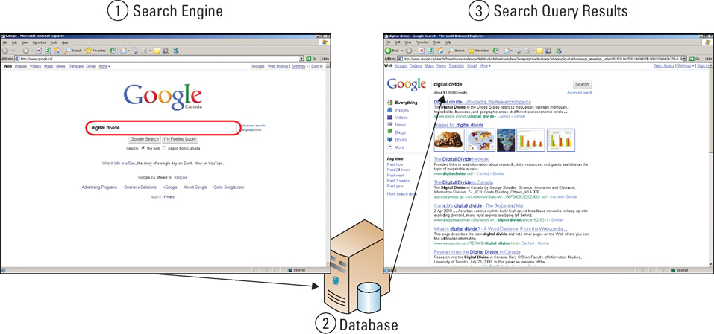
Data-Driven Web Sites
An interactive Web site which uses a database to keep it updated and relevant to the needs of its customers.
Notes:
Visitors select what they wish to view. A query (a request of the database) selects data and builds the web page views the visitor wants to see.
See page 233 in the text for an illustrated example of how Google works.

Slide 37
Data Driven Web Site Advantages
Development
Changes can be made anytime without reliance on developers or HTML expertise.
Content Management
No web programmer required and, therefore, reduced cost and administration.
Future Expandability
Able to grow faster as it is already adaptable
Human Error Minimized
Have “error trapping” mechanisms to ensure required information is correctly filled out
Notes:
See Figure 7.8 for more information on these points.

Slide 38
Data Driven Web Site Advantages
Reduced Production and Update Costs
Reduced requirement for expertise reduces labour and training cost.
Increased Efficiency
Because the sites are computer driven
Improved Stability
Data and designs reside in the database and not in a person whose talent may leave the organization at any time.
Notes:
See Figure 7.8 for more information on these points.

